Slide 1
PIP2001 Capstone Project
Review-2
HOSPIQ (Hospital Quick Finder)
Batch Number: ISR 07
Roll Number | Student Name
20211ISR0056 | AMULYA B
20211ISR0053 | SNEHA N
20211ISR0054 | BHAVANA A
20211ISR0049 | HEMANTH GOVINDA RAJ
Under the Supervision of,
Dr.Akshatha Y
Assistant Professor
School of Computer Science and Engineering Presidency University,Bengaluru
Name of the Program: B. TECH(Information Science and Engineering with AI and Robotics)
Name of the HoD: Dr.Zafar Ali Khan
Name of the Program Project Coordinator: Dr.Akshatha Y
Name of the School Project Coordinators: Dr. Sampath A K/Dr. Abdul Khadar A/Mr. Md Ziaur Rahman

Slide 2
Introduction
The Hospital Finder project is an innovative Android application designed to provide users with a simple yet powerful tool for locating hospitals in real-time, ensuring access to medical care is just a few taps away. Developed using Android Studio, the app leverages Google Maps API, location-based services, and a user-friendly interface to offer a seamless experience for users. Upon launching the app, it displays a list of nearby hospitals, complete with essential details such as address, contact numbers, and services offered. This feature is especially valuable in emergency situations, where immediate access to healthcare is critical.
Users can also perform custom searches by entering a hospital’s name, or by filtering hospitals based on specific criteria, such as the availability of certain medical services and emergency care or specialized departments like cardiology or pediatrics. The app provides directions to the selected hospital using Google Maps, guiding users with step-by-step navigation from their current location. Additionally, the app is designed to be adaptable across various scenarios, such as traveling or seeking healthcare in unfamiliar regions, making it an essential tool for users who may need assistance in quickly finding medical facilities.

Slide 3
Literature Review
SLNo. | Title | Description | Link
1 | Community Benefit Insight Data API | Provides hospital data filtered by state. Enables API integration to retrieve relevant hospital information | https://www.communitybenefitinsight.org/?page=info.data_api.
2 | Android Based Hospital Finder Using GPS | Utilizes GPS for finding the nearest hospital and providing a route using Google Maps API. | //www.academia.edu/36350507/ANDROID_BASED_HOSPITALFINDER_APPLICATION_USING_GLOBAL_POSITIONING_SYSTEM_GPS.
3 | Nearest Hospital Tracking and Disease Prediction | Helps locate the nearest hospital and predicts diseases for tailored treatments. Aims to save patients' time and provide prompt medical care. | https://scholarworks.calstate.edu/downloads/sj139245q.
4 | Hospital Locator and Bed Availability Detector for Emergency Cases | Web-service-based system to detect hospital location and bed availability, providing optimal emergency services. | https://www.irjet.net/archives/V9/i12/IRJET-V9I12142.pdf
5 | Domain-Specific Search for Hospitals and Clinics | Cloud-based database system for hospitals, clinics, and blood banks. Implements data mining to identify optimal hospitals and stores users' EHR. | https://www.ijatir.org/uploads/613452IJATIR5059-297.pdf
6 | Implementation of Hospital Finder for Ayush Hospitals | Develops an app for locating nearby Ayush hospitals, displaying opening and closing times, and integrating biomedical data for outpatient and inpatient details | https://ijrpr.com/uploads/V4ISSUE4/IJRPR11857.pdf.

Slide 4
Literature Review
Advantages:
Uses user location coordinates to find nearest hospital.
Implements google maps easier to locate the position.
User input filters to sort hospitals.
Viewing Hospital Details.
Suggest Doctor based on symptoms.
Appointment with Doctor.
View ratings.
Hospital distance and route.
Disadvantages:
Limited Accuracy of Location Services.
The data must be accurate and must reflect real time data.
Maintenance and Data Updating.
Battery and Data Usage.
Need to include all hospitals near use’s vicinity.
Inaccurate Disease prediction due to lack of physical examining patient.
Privacy and Data Security Concerns.

Slide 5
Proposed Method
Location-Based Services: Utilize GPS to accurately determine the user's location. Integrate the Google Maps API to display a map with hospital markers.
Hospital Data:Store hospital data locally for offline access and faster performance. Use a cloud database (e.g., Firebase, AWS Amplify) for real-time updates and synchronization.
Doctor Details:Create a dedicated page for each doctor to display their details in a clear and organized manner.
Search and Filtering:Allow users to search for hospitals by name, specialty, or location. Provide filters for hospital type, distance and availability.
Appointment Booking:Integrate with hospital booking systems to allow users to schedule appointments online.
User Friendly Interface:Create a user-friendly interface that is easy to navigate.
Security and Privacy:Protect sensitive user data (e.g., location, health information) using encryption.

Slide 6
Objectives
The main aim is to quickly locating the nearest hospitals within as per given radius.
Help patients save time by offering fast decision-making capabilities to choose hospitals with the desired medical specialists, treatment, and facilities.
Utilize GPS in smartphones for accurate hospital location and provide route guidance via Google Maps.
Allow patients to input symptoms for timely treatment.
Provide a user-friendly and informative application with details on Doctor appointment, Availability including contact information and websites.
Make it easier for users to access healthcare facilities no matter where they are especially in unfamiliar regions.
Provide the option for users to book doctor appointments and check availability in advance.

Slide 7
Methodology
Requirement gatherings and Design implementation phase.
Discuss functional requirements.
Set up the environment for application development.
Design UI for the app.
Plan the task.
Create APIs for front-end to leverage
Implement the code and features.
Testing

Slide 8
Timeline of Project
Task | Sep | Oct | Nov | Dec
1. Project Planning and Design | -------- - -
2. Development and Integration |  | ----------------------------
3. Testing |  |  | ------
4. Deployment and Final Review |  |  |  | ------

Slide 9
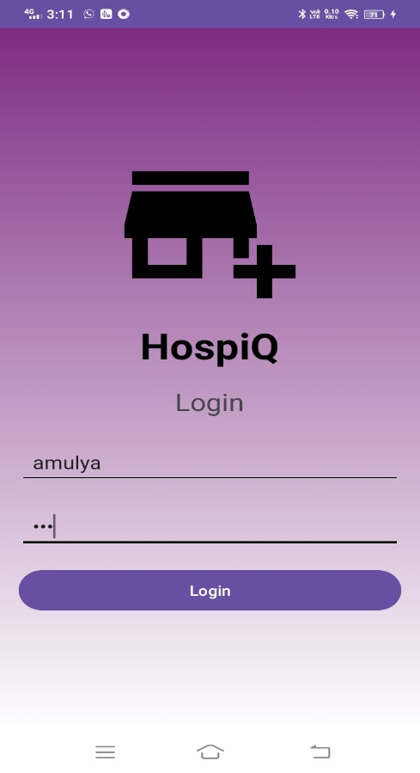
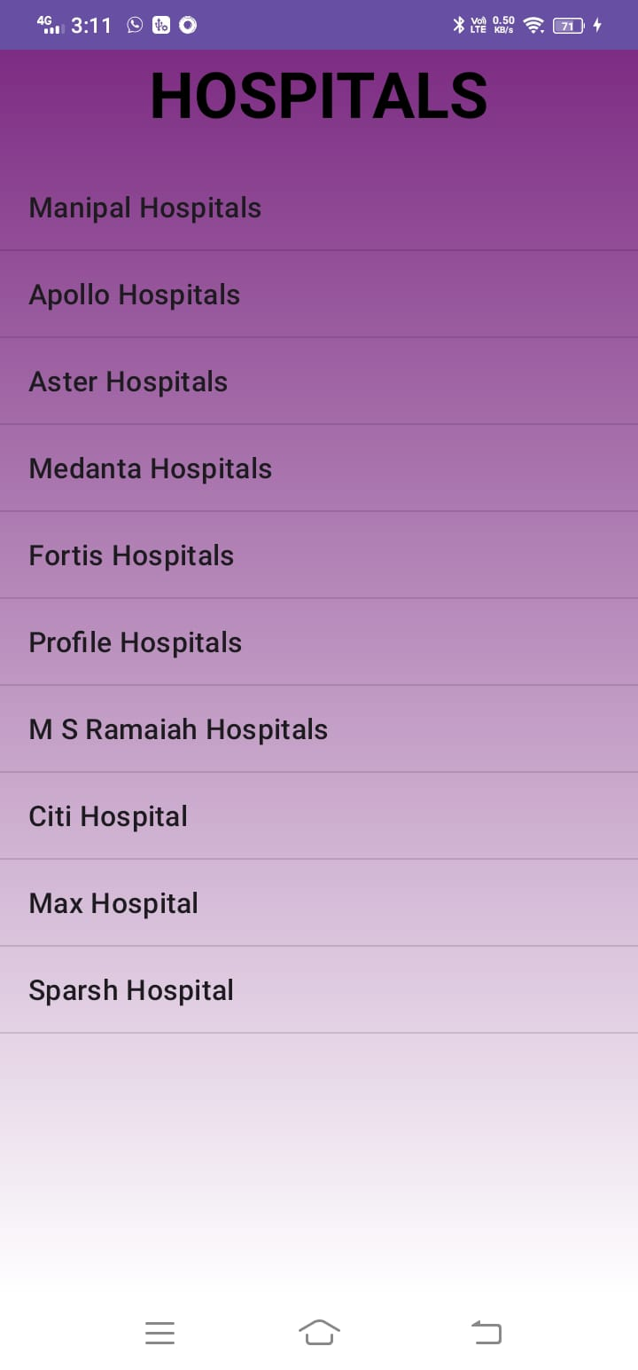
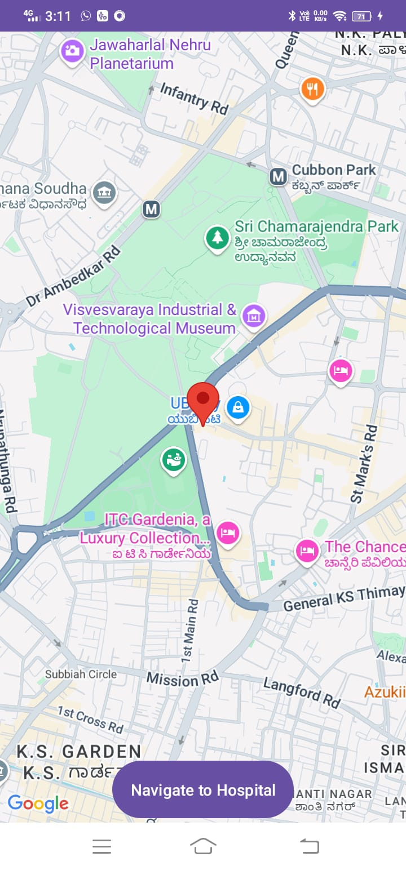
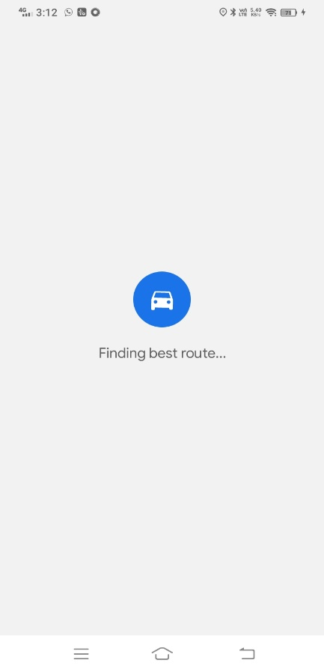
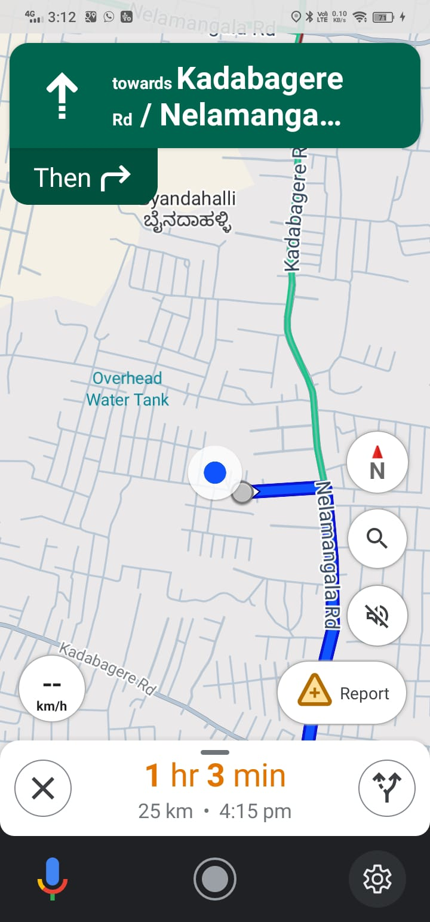
Expected Outcomes

Slide 10
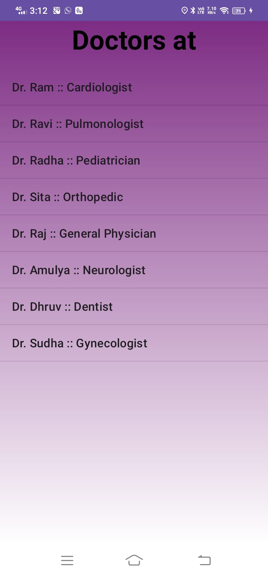
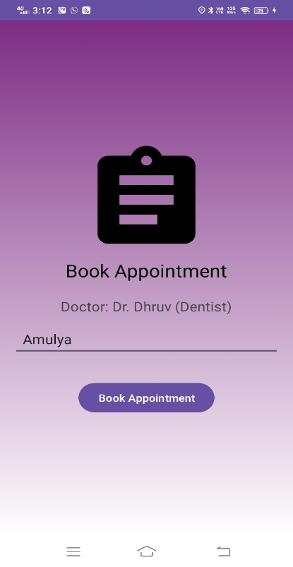
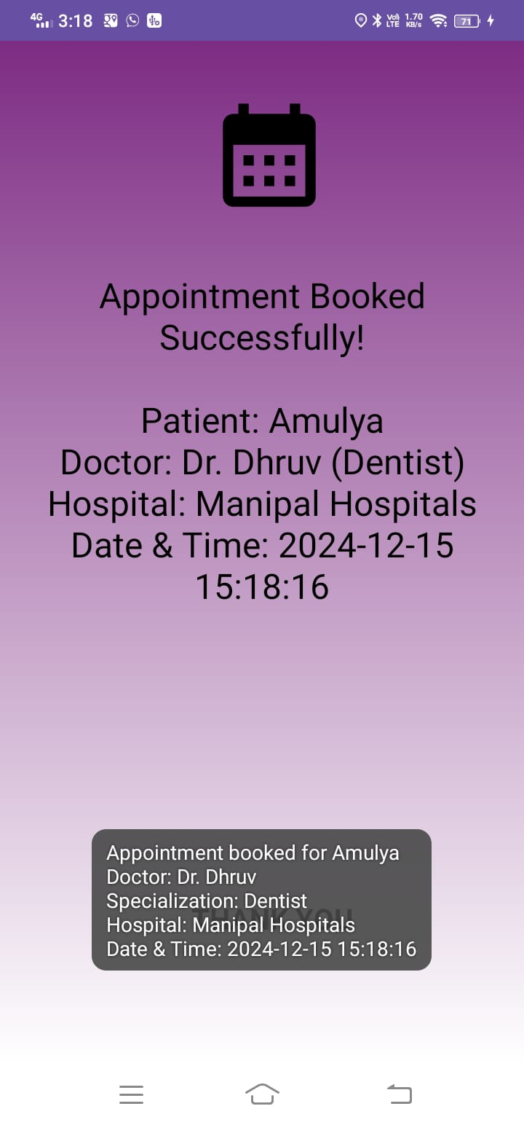
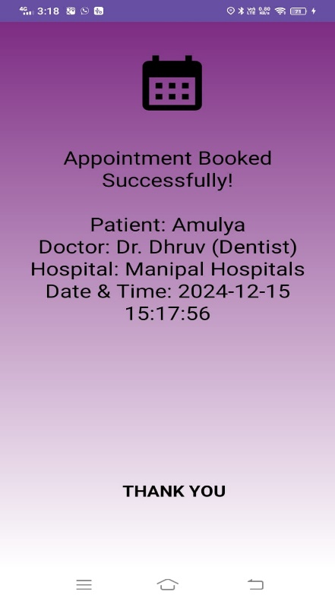
Expected Outcomes

Slide 11
Conclusion
The "HospiQ (Hospital Quick Finder)" represents a significant leap forward in healthcare accessibility and convenience. By harnessing the capabilities of modern technology, this app has successfully addressed the common challenges faced by patients in locating nearby hospitals and specialized medical professionals saving valuable time which can save a person from death in critical and emergency situation.
A well-designed hospital finder mobile app can significantly benefit both users and hospitals. Users can easily find nearby hospitals, access detailed information, and schedule appointments conveniently. For hospitals, the app can increase visibility, enhance patient experience, and collect valuable data. By tracking key performance indicators, app developers can optimize the app to meet the needs of both users and healthcare providers, ultimately improving healthcare access and satisfaction.

Slide 12
References
Geetha, Selvaraj, Samayan Narayanamoorthy, Thangaraj Manirathinam, and Daekook Kang. "Fuzzy casebased reasoning approach for finding COVID-19 patients’ priority in hospitals at source shortage period." Expert Systems with Applications 178 (2021): 114997.
Ravaghi, H., Alidoost, S., Mannion, R. and Bélorgeot, V.D., 2020. Models and methods for determining the optimal number of beds in hospitals and regions: a systematic scoping review. BMC Health Services Research, 20(1), pp.1-13.
Kittipanya-Ngam, Panachit, Ong Soh Guat, and Eng How Lung. "Bed detection for a monitoring systemin hospital wards." 2012 Annual International Conference of the IEEE Engineering in Medicine and Biology Society. IEEE, 2012.
McClean, Sally, and Peter H. Millard. "A decision support system for bed- occupancy management and planning hospitals." Mathematical Medicine and Biology: A Journal of the IMA 12, no. 3-4 (1995): 249-257
Rinartha, K., & Suryasa, W. (2017). Comparative study for better results on query suggestion of articlesearching with MySQL pattern matching and Jaccard similarity. In 2017 5th International Conference on Cyber and IT Service Management (CITSM) (pp. 1-4). IEEE.
[18] Mr. Anand D. Acharya, "IOT based Health Care Monitoring Kit", International Conference on Computing Methodologies and Communication, pp:110- 115(2020)

Slide 13
Thank You

